Slide 1
Movie Ticket Booking Application
An user-friendly mobile application.

Slide 2
Features

Slide 3
Features
User Account
Movie Listing
Users should be able to create their own personalized account.
The account must contain the history of the user’s prior booking and the movies they have rated and reviewed.
Using the information history, movies can be suggested with the flair of the user’s personal taste to enhance their experience within the application.
The application should be able to showcase the list of available move that are currently being screened.
Each of the movies must have a short description to it, along with the main cast and crew, in order to attract audience.

Slide 4
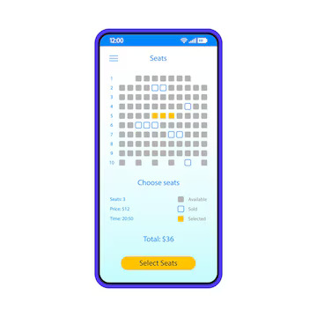
Features
Ticket Booking
The ticket booking process must start off with the list of available shows that are currently being screened.
Then after choosing the desired show, the list of available and the occupied seats are to be shown distinctly.
Prior to confirming the booking, the information has to be confirmed by the user.

Slide 5
Features
Payment Methods
Review and Rating System
The user must be able to freely choose from various payment methods such as debit, credit and other payment gateways such as PayPal etc.
The user must have the ability to add and modify their personal rating and review to any movie of their choice.
And must also be able to freely view the ratings of the other users.

Slide 6
Features
Discount Coupons
Loyalty Rewards
To attract users, frequent offers and discounts are to be planned accordingly.
These act as a marketing strategy to increase the number of users and is predicted to be contributing towards the profit margins.
Users should be rewarded with discounts and other offers for being a loyal user to the application.
The rewards may include offers to partnered brands and facilities.

Slide 7
Nisanth Saravanan

